Slide 1
Scribe Case study
Jeffrey Cuevas, data analyst

Slide 2

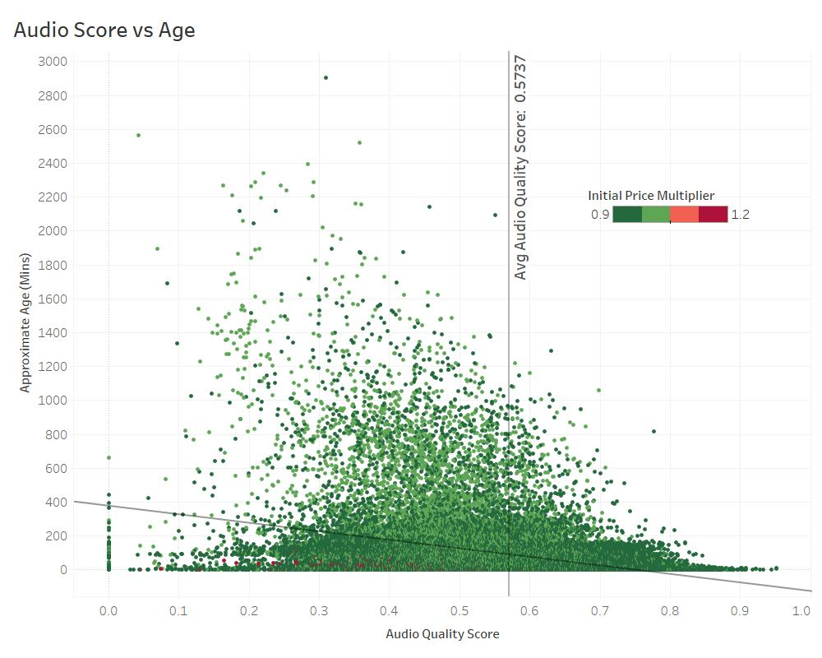
Factors most predictive of higher job claim times – Audio Score
Negative linear correlation between Audio Quality Score and Age.
The lower a job’s audio quality score is, the more likely it is to experience a higher claim time.
Observation: larger initial price multipliers are not common, even in the extreme jobs with low audio quality scores and high approximate age.
Intercept: 376.73
Score Coefficient: -502.68
p-value: < 0.0001
Conclusion: Audio score likely influences claim time.

Slide 3
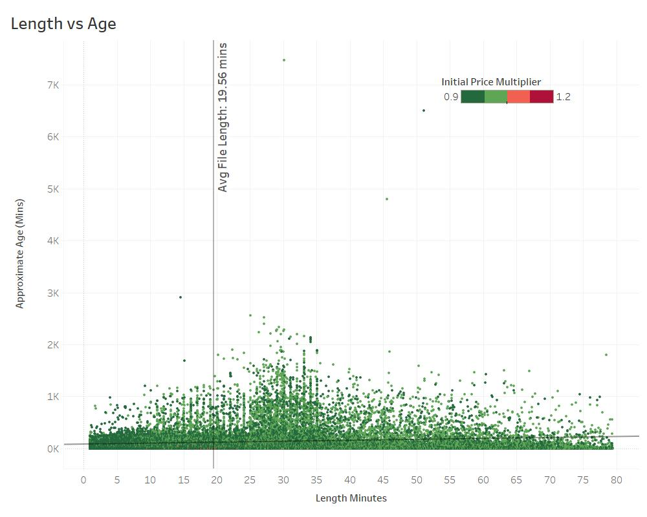
Factors most predictive of higher job claim times – File Length
Miniscule positive linear correlation between File Length and Age.
Observation: larger initial price multipliers are not common, even in the extreme jobs with low audio quality scores and high approximate age.
Intercept: 85.02
File Length Coefficient: 1.81
p-value: < 0.0001
Conclusion: file length doesn’t significantly affect claim time.

Slide 4
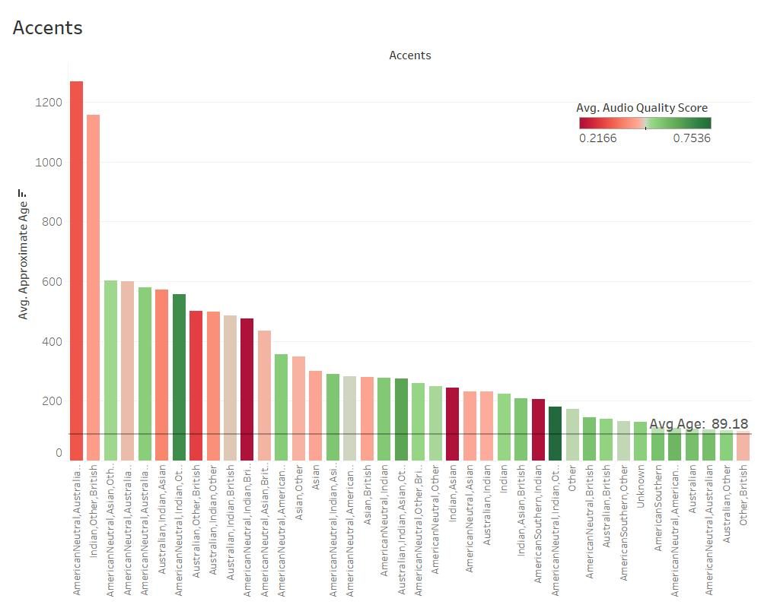
Factors most predictive of higher job claim times – Accents
Specific accent combinations result in higher claim times compared to our average of 89.18 minutes.
In general, we can also see that these accent combinations with high claim times are associated with lower audio quality scores.
These accent combinations account for a small percentage of the total number of jobs, but could help with flagging potential high claim time jobs moving forward.

Slide 5
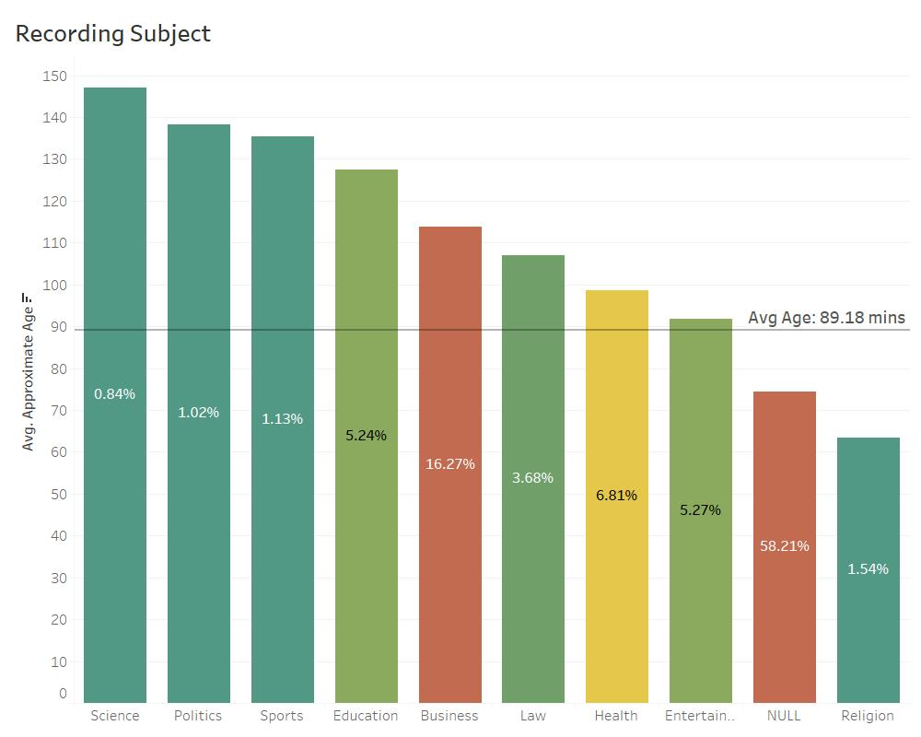
Factors most predictive of higher job claim times – Recording Subject
Specific recording subjects result in higher claim times compared to our average of 89.18 minutes.
In general, individual recording subjects account for a small percentage of the total number of jobs, but could help with flagging potential high claim time jobs moving forward.
For example, Business category needs improvement.

Slide 6
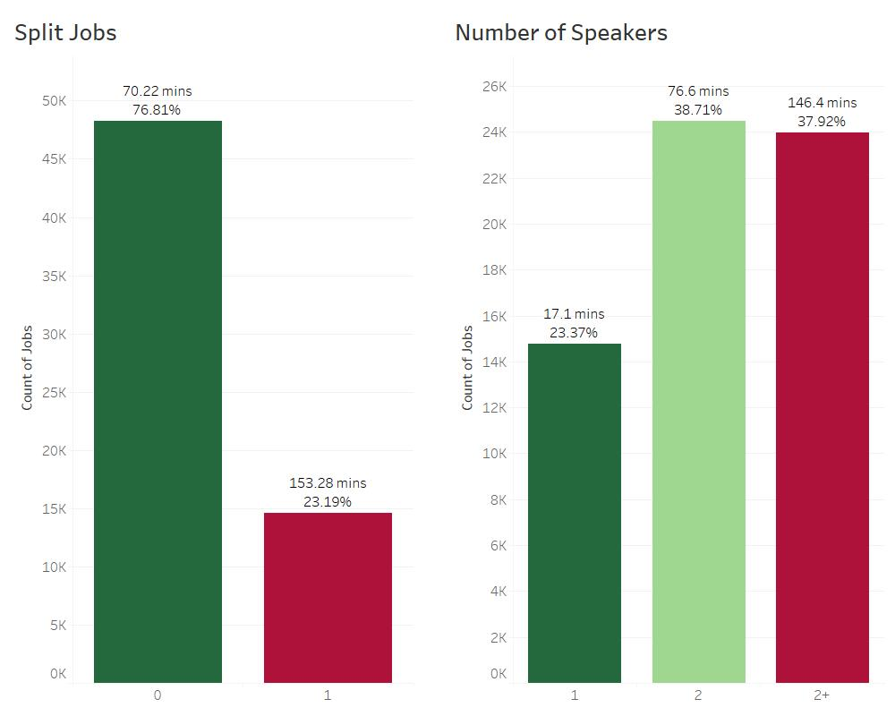
Factors most predictive of higher job claim times – Split Jobs & Number of Speakers
Split Jobs
On average, split jobs take twice as long to complete and they account for 23.19% of our dataset.
This could be a great indicator for predicting job claim times.
Number of Speakers
On average, jobs with 2+ speakers takes twice as long to complete than jobs with 2 speakers and eight times as long to complete than jobs with 1 speaker.
Jobs with 2+ speakers account for almost 38% of our dataset.
This could be a great indicator for predicting job claim times.
Split Job | % of Total Jobs | Avg Audio Quality Score | Avg Approximate Age (mins) | Count of Jobs
Yes | 76.81% | 0.5833 | 70.22 | 48,234
No | 23.19% | 0.5471 | 153.28 | 14,566

Slide 7
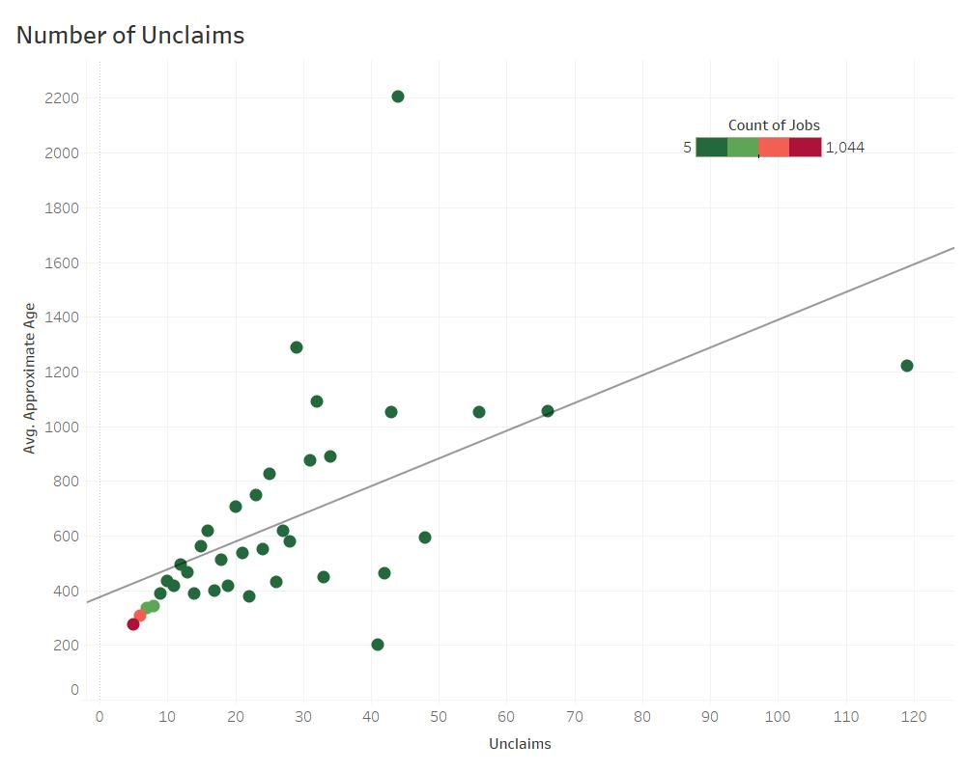
Number of Unclaims
Not a predictive indicator when a job is submitted, but could be used as a flag while job is sitting.
Positive linear correlation between number of unclaims and average bin age.
Most likely due to other factors but worth looking into.
The more unclaims a job has, the more likely it is to experience a higher claim time.
Intercept: 374.73
Unclaims Coefficient: 10.24
p-value: 0.0003214
Conclusion: number of unclaims likely influences claim time.
Future analysis: find specific trends in the subset of data with a high number of unclaims.

Slide 8
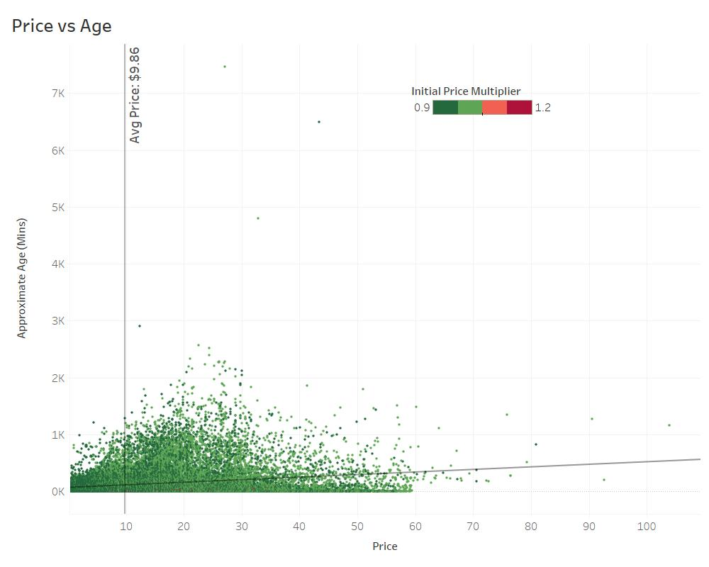
Factors most predictive of higher job claim times – Price
Positive linear correlation between Price and Age.
The higher a job’s price is, the more likely it is to experience a higher claim time.
Most likely due to other factors but worth looking into.
Intercept: 70.62
Price Coefficient: 4.51
p-value: < 0.0001
Conclusion: price likely influences claim time.

Slide 9
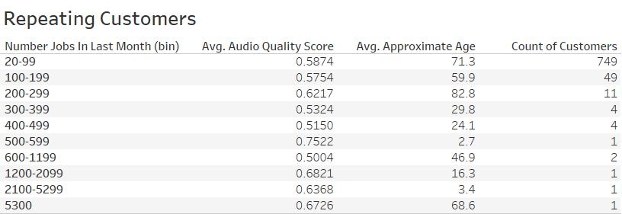
Repeating Customers
It’s important to look at customers that use Rev’s service for multiple jobs.
Customers who submitted at least 20 jobs within the timeframe of this case study are all below our average claim time of 89.18 minutes.
We can infer that higher claims times are not associated with customers that submit a large number of jobs.

Slide 10
If you had a 15-minute file with 1 speaker and an Audio Quality Score of 0.65074, what would you say about its estimated claim time?
Utilized multiple linear regression with R code for this analysis.
Filtered the dataset on Number of Speakers = 1 and excluded NULL values.
Used a multiple linear regression model to find the following parameters:
Used the regression coefficient values in the following equation to estimate claim time:
Claim Time = 50.32 + (-60.52 * 0.65074) + (0.02032 * 900) = 29.23 minutes
All p-values < 0.001, so we can conclude that both audio quality score and file length likely influence claim time.
Conclusion: Jobs with these specific variables will be claimed extremely fast.
 | Regression Coefficient | Standard Error | t value | p value
Intercept | 50.32 | 2.077 | 24.23 | < 0.001
Audio Quality Score | -60.52 | 3.102 | -19.51 | < 0.001
Length Seconds | 0.02032 | 0.0009853 | 20.61 | < 0.001

Slide 11
Propose one change to the way Scribe sets the Initial Price.
Set the minimum Initial Price multiplier at 1.2 for jobs that meet ALL of the following criteria:
Number of Speakers = 2+
Audio Quality Score below our dataset average of 0.5737
File Length below our dataset average of 19.56 minutes
Is Split Job = 1
Recording Subject groups that are above our average age of 89.18 minutes
Business, Education, Entertainment, Health, Law, Politics, Science, Sports
This is a worst first approach
This is a small change. If successful, the above criteria could be adjusted to cast a larger net of jobs.
In our current dataset, this would apply to only 378 jobs with an average age of 499.92 minutes.
But this could be a useful mechanism for testing if an initial price change could be scaled up.

Slide 12
What objectives are you trying to achieve with this change?
The first and main objective is to decrease claim time
The second objective is to increase customer satisfaction, thus driving more business in future months.
The third objective is to increase revenue.
The idea is that we target these “problem” jobs in a timely manner by paying the Agents a higher fee. Lower claim times will result in Rev’s service being used more by new and existing customers.

Slide 13
What implications do you think this change would have on the marketplace?
This change could make Agents target these specific jobs. They know they could potentially make more money. This could negatively affect claim times for simpler jobs.
The marketplace could also see an increase in Agents due to the fact they are able to make more money.
It’s possible, depending on scale of the change, the company will have decreased revenue over future months. Currently, this subset has an average initial price multiplier of 0.96. Raising the initial price multiplier to 1.2 on a large scale could have major revenue implications.

Slide 14
What metrics would you look at to measure success?
Calculate regression coefficients for our quantitative variables and monitor weekly/monthly. Compare with data before change was implemented.
Decrease proves our predicted claim times will be getting smaller.
Increase proves our predicted claim times will be getting larger.
Calculate average claim time and monitor weekly/monthly. Compare with data before change was implemented.
Calculate median claim time and monitor weekly/monthly. Compare with data before change was implemented.
Indicator for success in case data is distorted due to outliers.
Calculate standard deviation of claim time and monitor weekly/monthly. This will measure consistency in claim time.
Lower standard deviation values prove claim time is becoming more consistent.
Calculate and monitor average claim time for each variable included in the price increase criteria.
Create a dashboard with all metrics.

Slide 15
How would you test this change?
Take a sample of jobs that meet our criteria and change the initial price multiplier to 1.2. Record this sample data for a few weeks or months.
Conduct hypothesis testing:
Alternate Hypothesis – Jobs that have an initial price multiplier of 1.2 will have decreased claim times.
Null Hypothesis – Jobs that have an initial price multiplier of 1.2 will not have decreased claim times.
Calculate standard deviation from a sample dataset with the change implemented.
Calculate standard deviation from a sample dataset without the change implemented.
Calculate the variance between the two datasets.
Calculate t-score with a t-test.
Evaluate significance with a t-table
If data is statistically significant, we reject the null hypothesis and accept the alternate hypothesis.

Slide 16
What concerns or risks do you have about your recommendation?
Main concern is that this change won’t have a large enough impact on decreasing overall claim time for the entire dataset. But I’d feel better making a small change with a lower risk for major implications and then slowly scaling that change up as success is measured.
Automatically assigning jobs with a higher initial price multiplier could have a negative impact on the market as a whole.
Easy jobs could experience higher claim times.
Agents could become selective in the jobs they choose by only wanting the ones with an initial price multiplier of 1.2.
What second-order effects do you anticipate and how might you mitigate these?

Slide 17
What other information might you want before moving forward with your recommendation?
I would want to look at historic Jobs data from at least the previous 12 months to get a better understanding.
I would also want the company’s financial data from at least the previous 12 months prior to the change being implemented. Accounting for changes in other financial variables outside the scope of this solution, we could track the net revenue of this specific change.

Slide 18
Thank You!
Questions?

